Slide 1
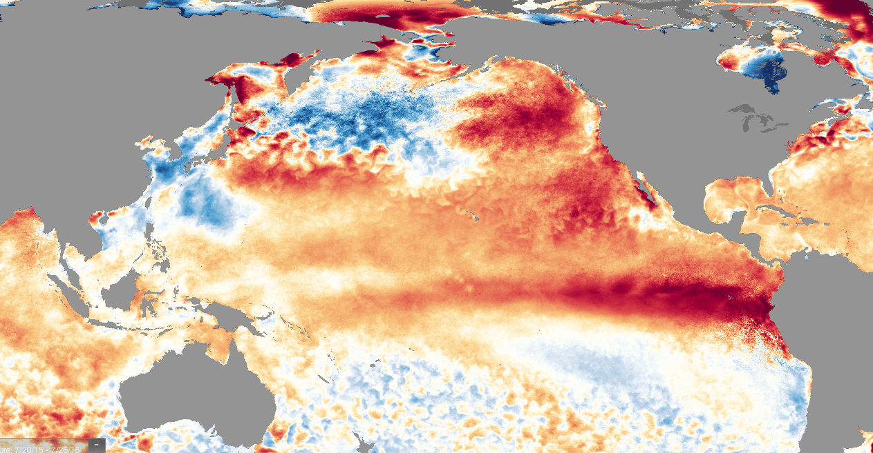
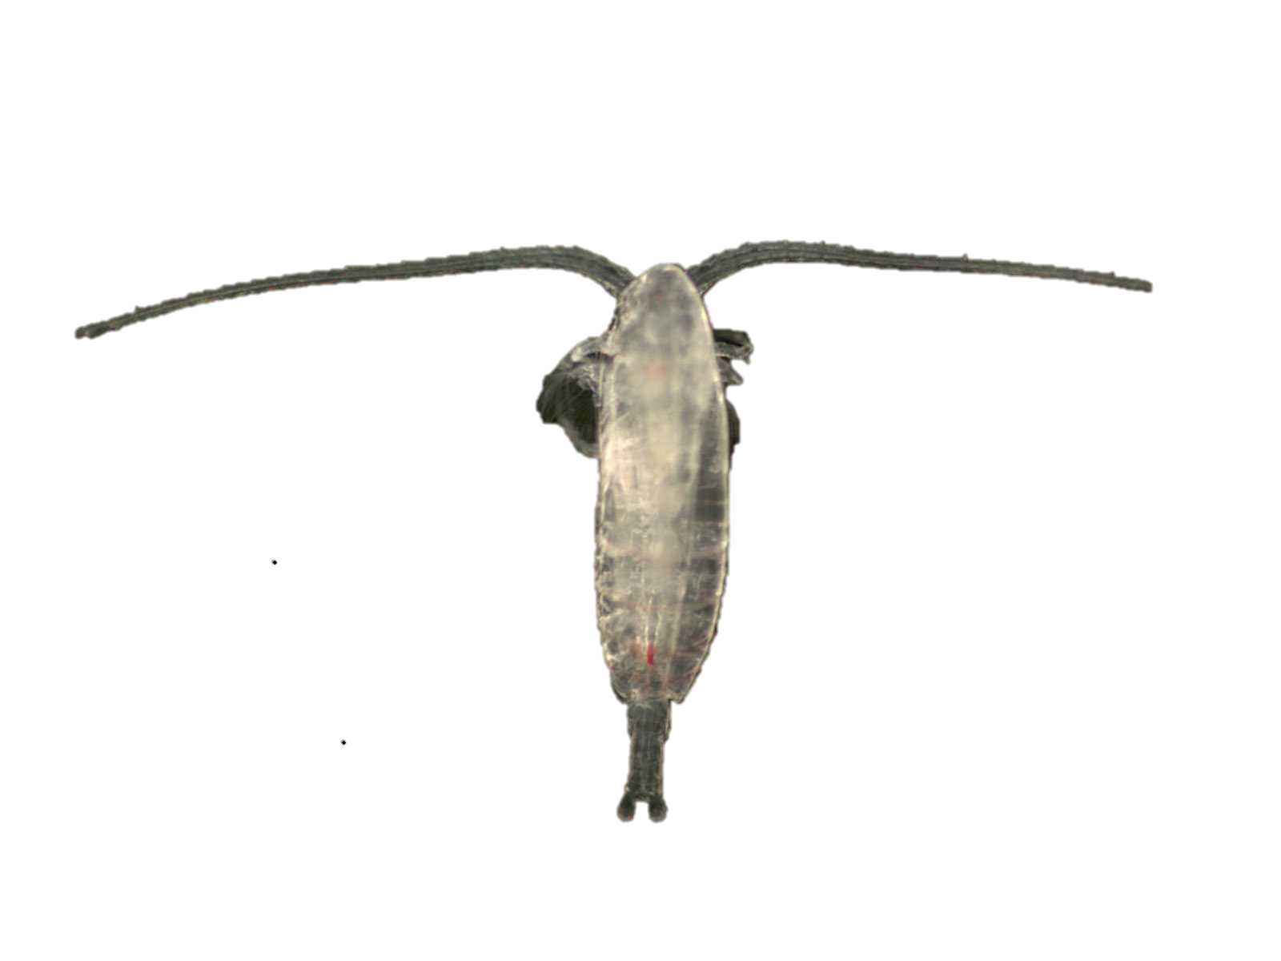

Cranking up the Heat: Impacts of the Marine Heatwave on Copepod dynamics
Weekly SST anomaly, July 20, 2015
Andrew Leising NOAA-SWFSC, FATE-FTE

Slide 2
Marine heatwave of 2014-2016 aka “The Blob”
Unprecedented T increase for 3 years
Strong subsurface component
Altered species distributions and community structure (rare species, range shifts etc.)
Q: What were impacts on common species, and zooplankton in particular?

Slide 3
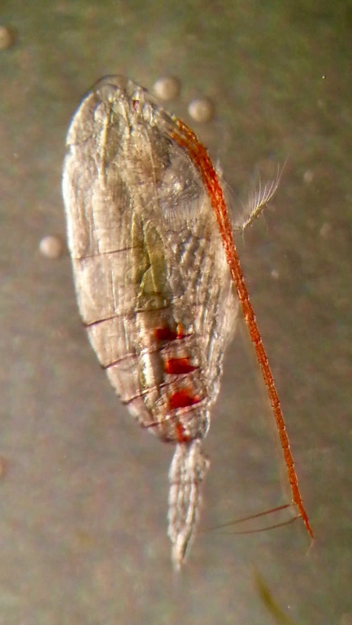
Copepods are dominant consumer: response to T, but almost never modeled as such…..
Calanus pacificus (most dominant copepod) growth vs temperature and food
G = 15% per day
G = 30%
per day
G = 11% per day
Photo Credit: Olivier Glippa

Slide 4
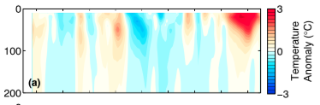
MHW had big impacts on surface and importantly SUBSURFACE properties
CalCOFI line 90 from gliders
Zaba and Rudnick, 2016

Slide 5
C. pacificus life cycle
10
Chlorophyll
0
Depth
Dormant phase
Vertical Migration
300
Jan Jun Dec
Time (months)

Slide 6
How will temperature affect cycle?

Slide 7
How will temperature affect cycle?
10
Chlorophyll
0
Will affect egg production, growth and development rate of all stages
Will affect terminal size of adults
Depth
Vertical Migration
300
Jan Jun Dec
Time (months)

Slide 8
How will temperature affect cycle?
10
Chlorophyll
0
Depth
Vertical Migration
Will affect number of generations during summer (since T affects development time)
300
Jan Jun Dec
Time (months)

Slide 9
How will temperature affect cycle?
10
Chlorophyll
0
Depth
Will affect lipid stores before going dormant, so length of dormancy
Vertical Migration
Dormant phase
300
Jan Jun Dec
Time (months)

Slide 10
Why does this matter to fisheries?

Slide 11
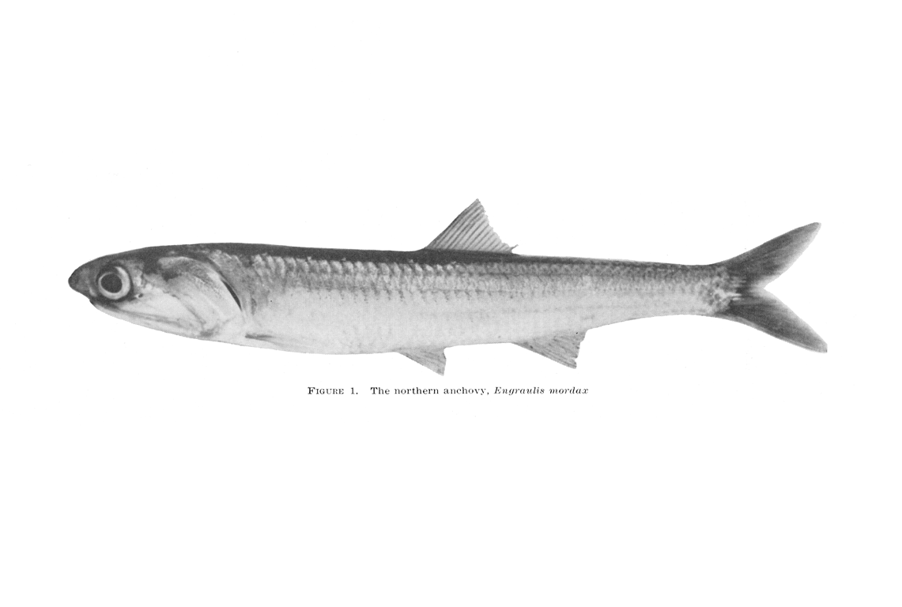
Why does this matter to fisheries?
r
1)
Φ
Size matters….E rate = π(r sin (Φ)²vN

Slide 12
Why does this matter to fisheries?
r
1)
Φ
Size matters….E rate = π(r sin (Φ)²vN
2)
But quality also important….Fat, lipid rich better than thin, skinny prey

Slide 13
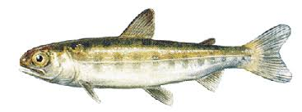
Why does this matter to fisheries?
r
1)
Φ
Size matters….E rate = π(r sin (Φ)²vN
2)
But quality also important….Fat, lipid rich better than thin, skinny prey
3)
Timing is everything

Slide 14
Approach:
Use detailed Individual-Based Model (IBM) of Calanus pacificus
Force with Temperature profiles from SPRAY gliders (http://spraydata.ucsd.edu)
Examine resulting size of adults, egg production, and population dynamics
Compare “standard year” with last few unique years

Slide 15
The Calanus IBM: 101
Adult Female
Egg – N2 = no growth
CV can go dormant based on lipid stores
N3 = first feeding
N 4-6
DVM = CIV ->
Forage from N3 on
5 copepodite stages

Slide 16
Model runs:
3 year run of climatology, with UI or SeaWifs as prey index
Use climatology as spin up, then run model forward for 2014-2016
Temperature data from Spray Gliders (Rudnick and Zaba, SIO)

Slide 17
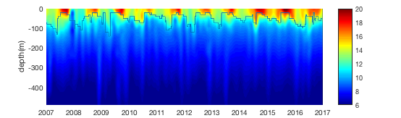
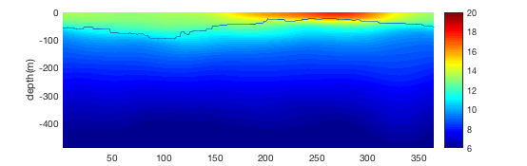
Temperature Forcing
Forcing for Blob years
Climatology, 2007-2013
Forcing for “standard years” and spin up

Slide 18
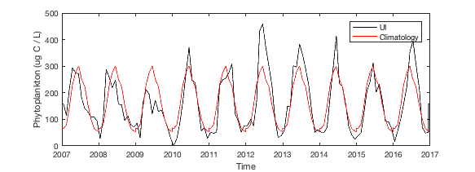
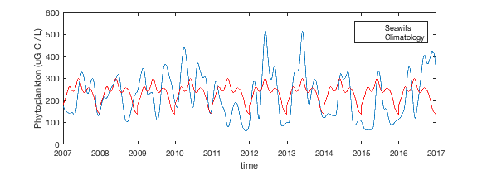
Prey forcing
Upwelling Index as Prey Index
SeaWifs as Prey Index

Slide 19
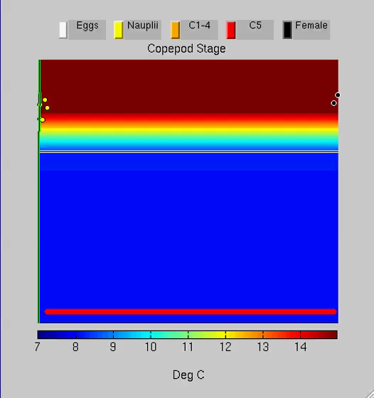
Example model run
1D water column
Copepods go through all life stages
Vertically migrate
Go dormant based on lipid stores
Background color is water Temp
Green line is Food
Each dot is one copepod
2 year example
1 image per day (night) so DVM not shown

Slide 20
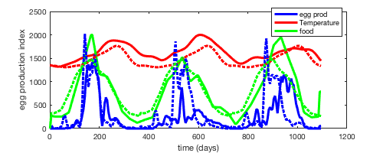
Results, Upwelling as Prey: Egg production

Slide 21
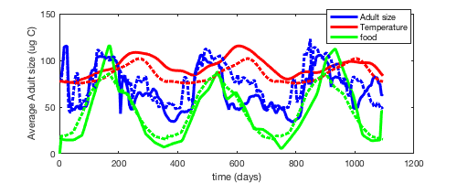
Results, Upwelling as Prey: Adult Sizes

Slide 22
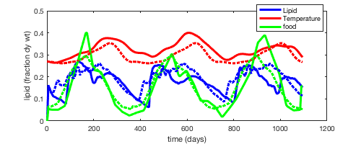
Results, Upwelling as Prey: Fat content (fraction lipids)

Slide 23
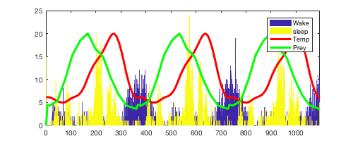
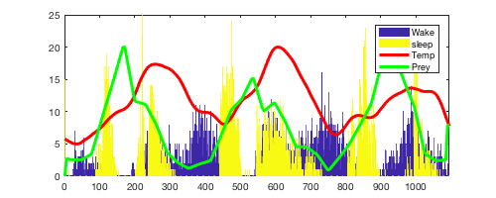
Results, Upwelling as Prey: Timing, Wake and Sleep times
Climatology
2014-2016

Slide 24
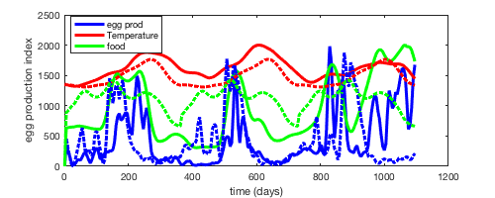
Results, SeaWifs as Prey: Egg production

Slide 25
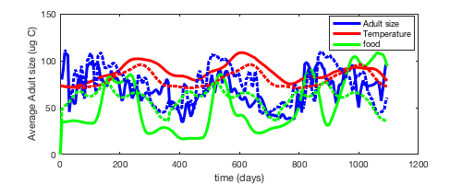
Results, SeaWifs as Prey: Adult Size

Slide 26
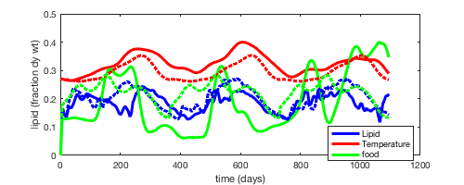
Results, SeaWifs as Prey: Fat content

Slide 27
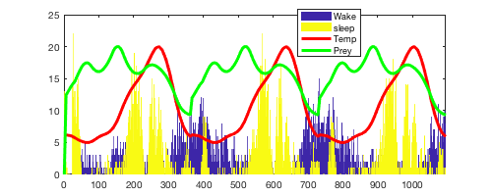
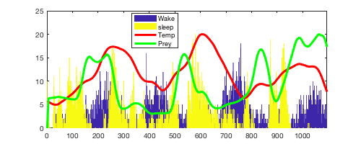
Results, SeaWifs as Prey: Timing
Climatology
2014-2016

Slide 28
Conclusions:
Egg production decreased during 14-15-16, except 16 in SeaWifs forcing

